Slide 1
Hotel Management
Name:
1] Shaikh Alfiya Rizwan
T.Y. BCA(science)
E-mail: shaikhalfiya193@gmail.com
2] Shelke Sushma Sunil
T.Y.BCA(science)
E-mail: shelkesushma18@gmail.com

Slide 2
Introduction:
This project, “ Hotel Management System” provides the Owner to communicate the customer Online.
The manual work is easy to handle, it saves time of the consumer and they don’t need to be present physically. We update the Hotel Information monthly.
In this project, we take review from customer and do changes it accordingly.

Slide 3
Reservation System:
If you want to Book/Reserve a table you can book it from our website.
The most important advantage of Online Booking is Convenience.

Slide 4
ER Diagram :
Handles
1
1
Admin
Hotel
Has
Provide
M
Waiter
M
Home
Delivery
M
Chefs
M
Has
Reservation
M
Menu
Book
Online
Phone call
Ice-Cream
Indian
Chinese
South Indian

Slide 5
Future Enhancement :
Our rooms are under construction , we will be providing rooms for stay.
You might get to know about table reservation from our website .
We are going to increase our cuisines as per customer wish.
By looking feedback page, going to make changes .

Slide 6
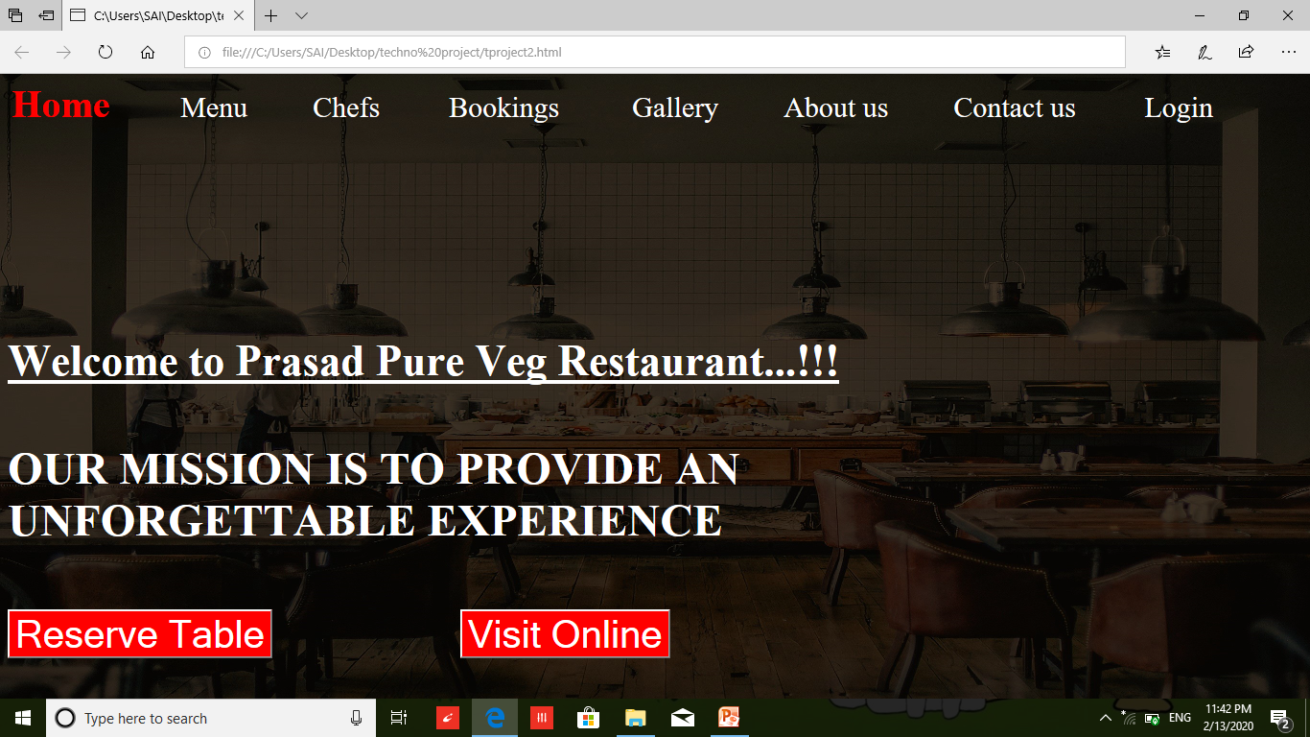
Screenshots :
Home page:

Slide 7
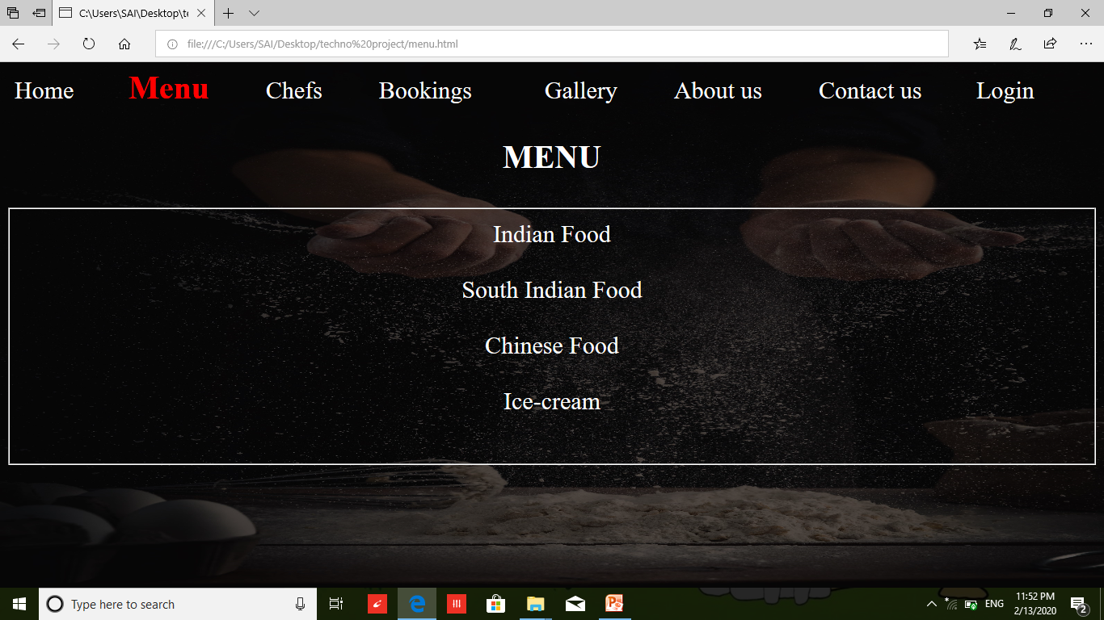
Menu Page :

Slide 8
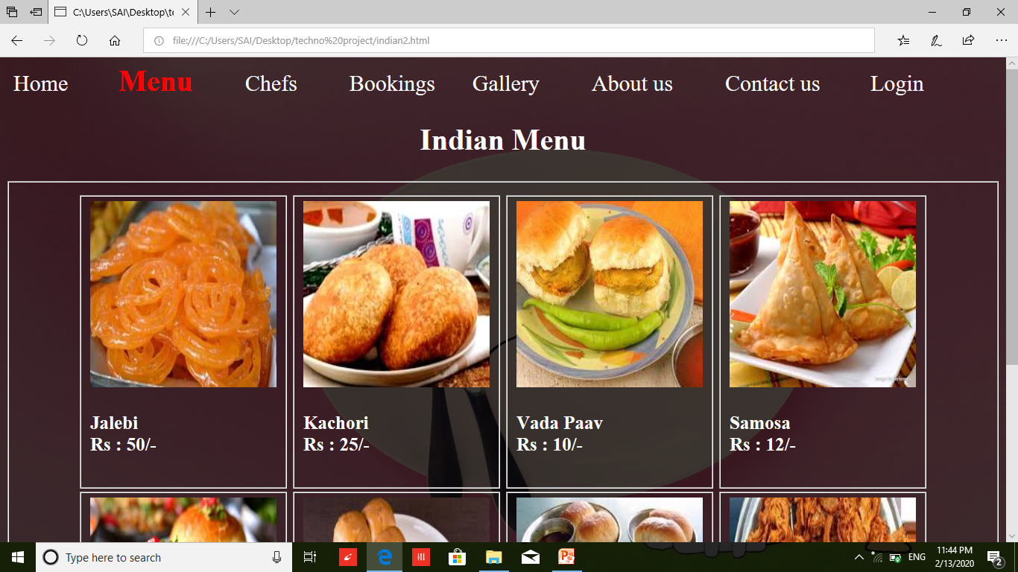
Menu:
Indian Menu

Slide 9
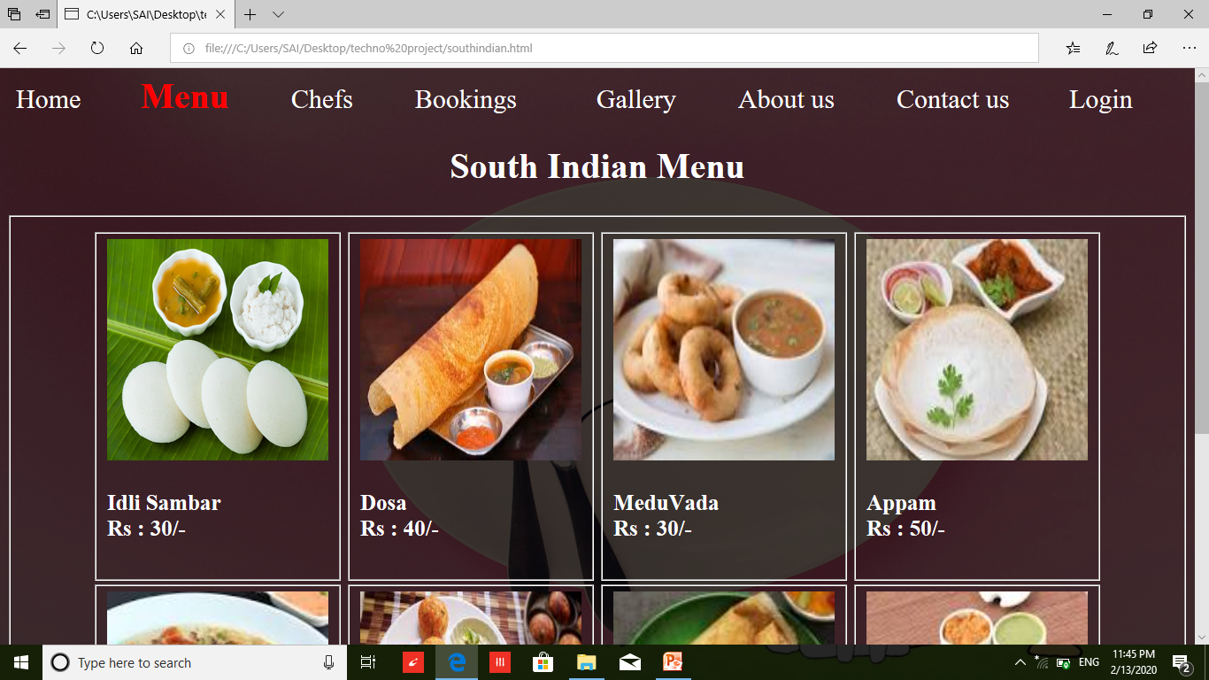
Menu:
South Indian Menu

Slide 10
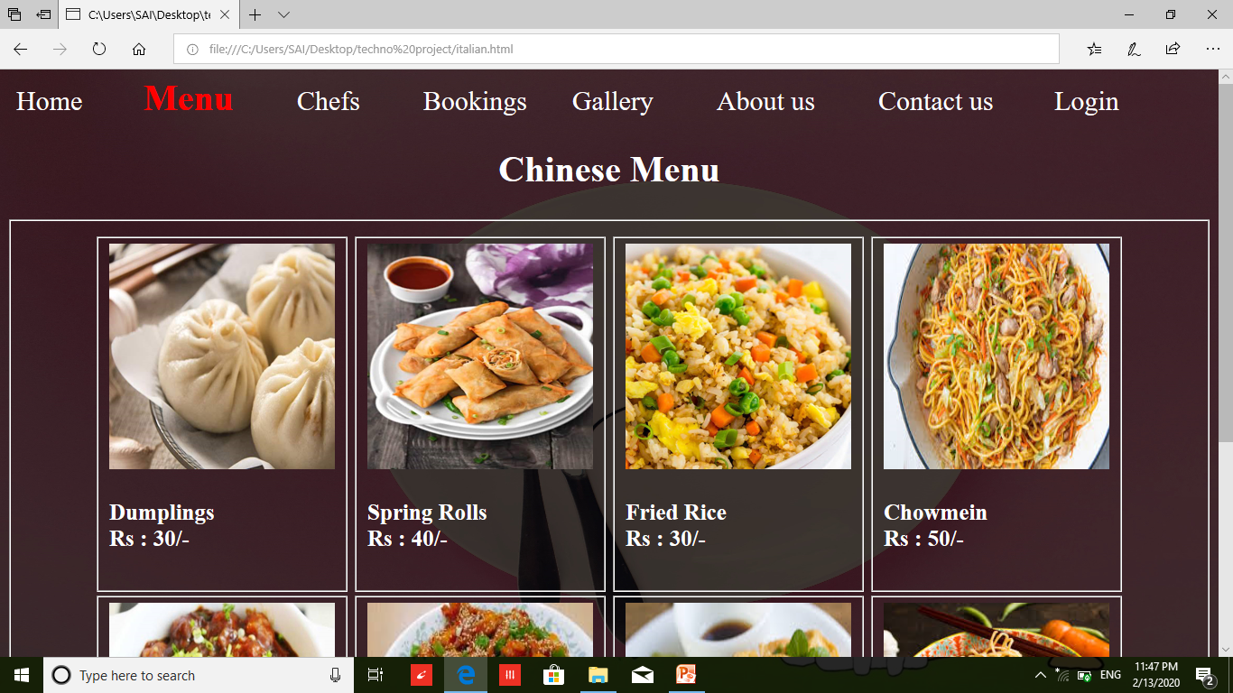
Menu:
Chinese Menu

Slide 11
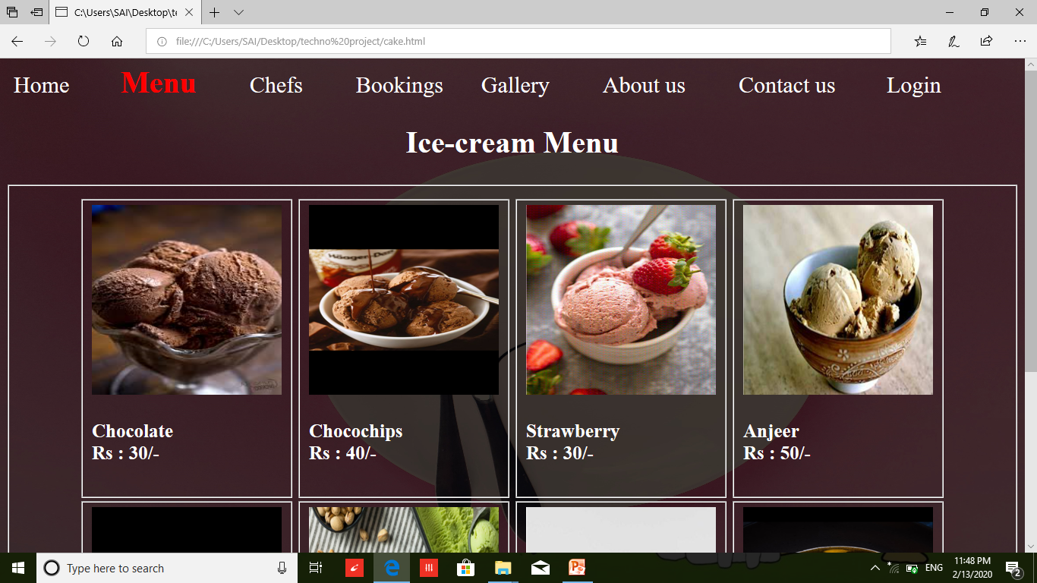
Menu:
Ice-cream Menu

Slide 12
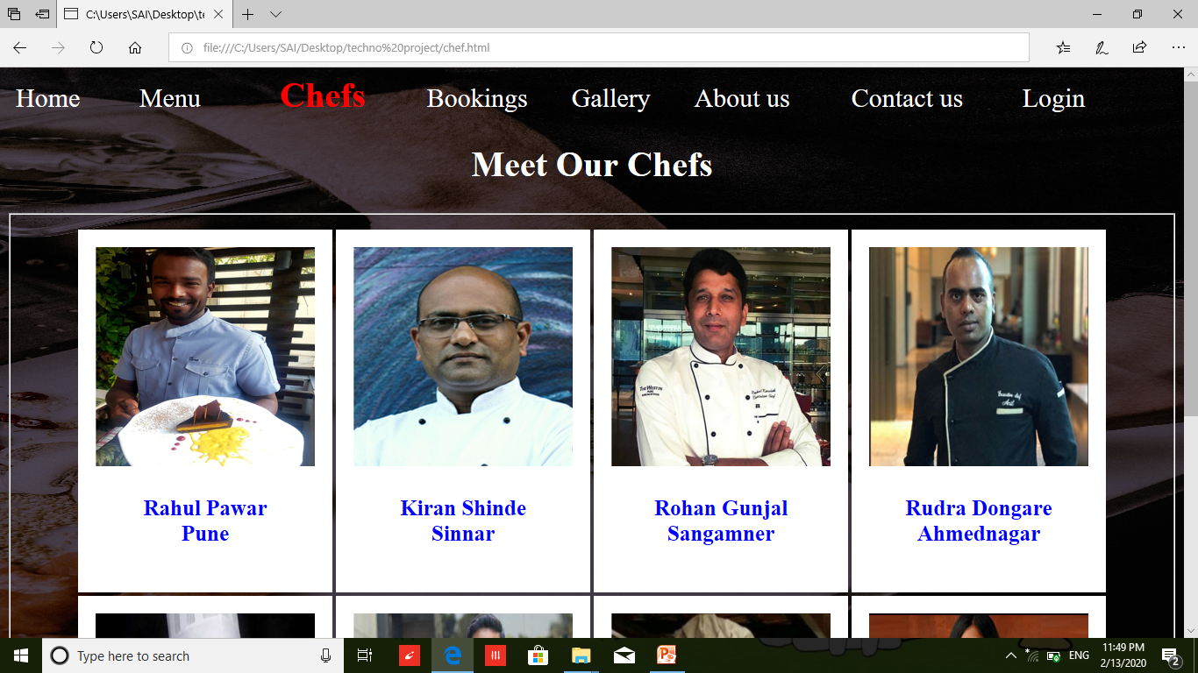
Chefs

Slide 13
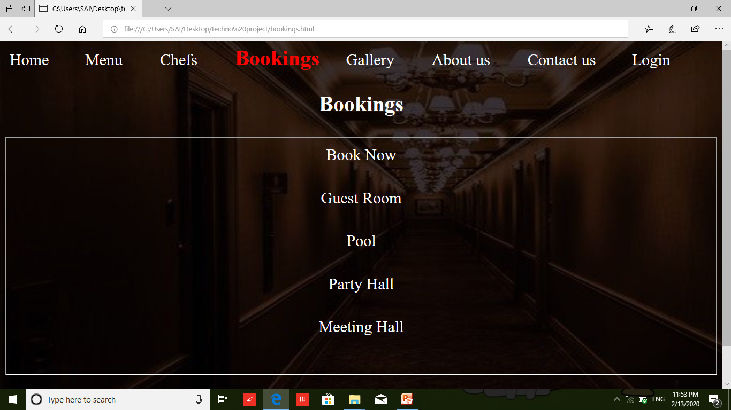
Bookings :

Slide 14
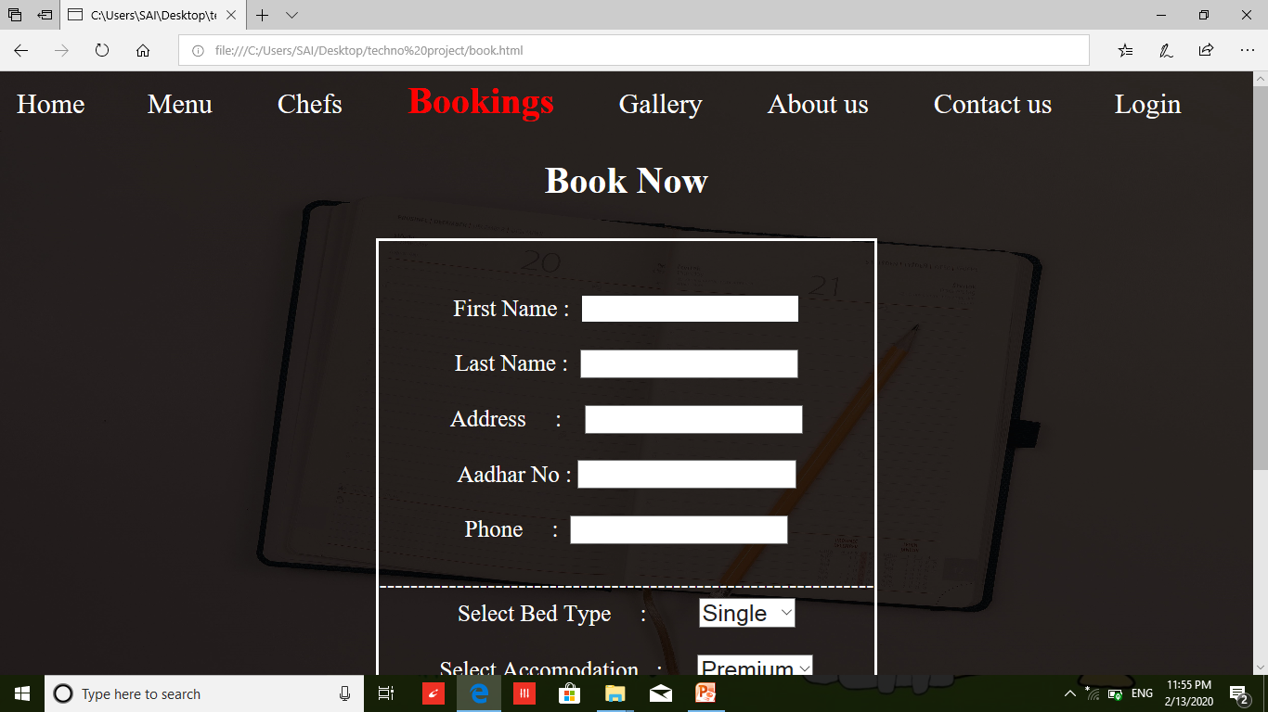
Bookings :- Book now page

Slide 15
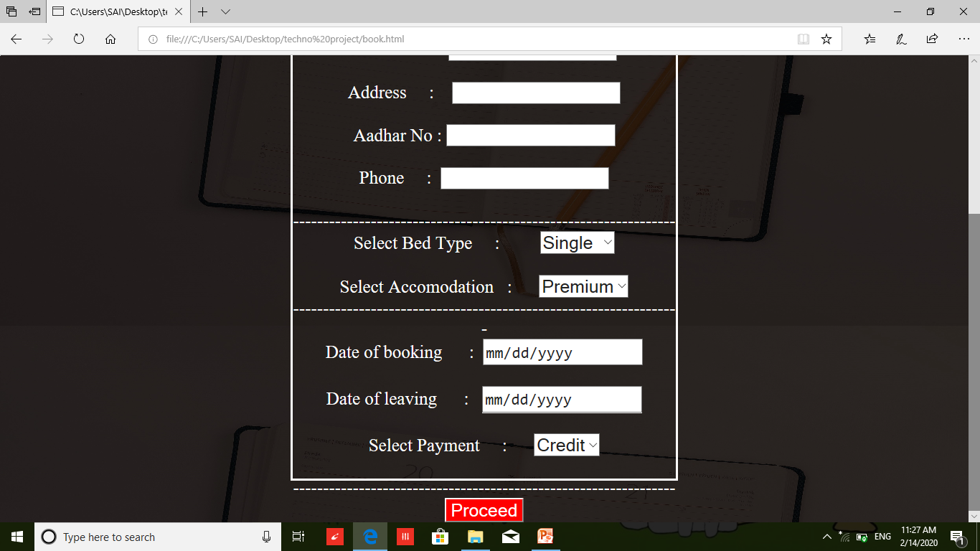
Book now

Slide 16
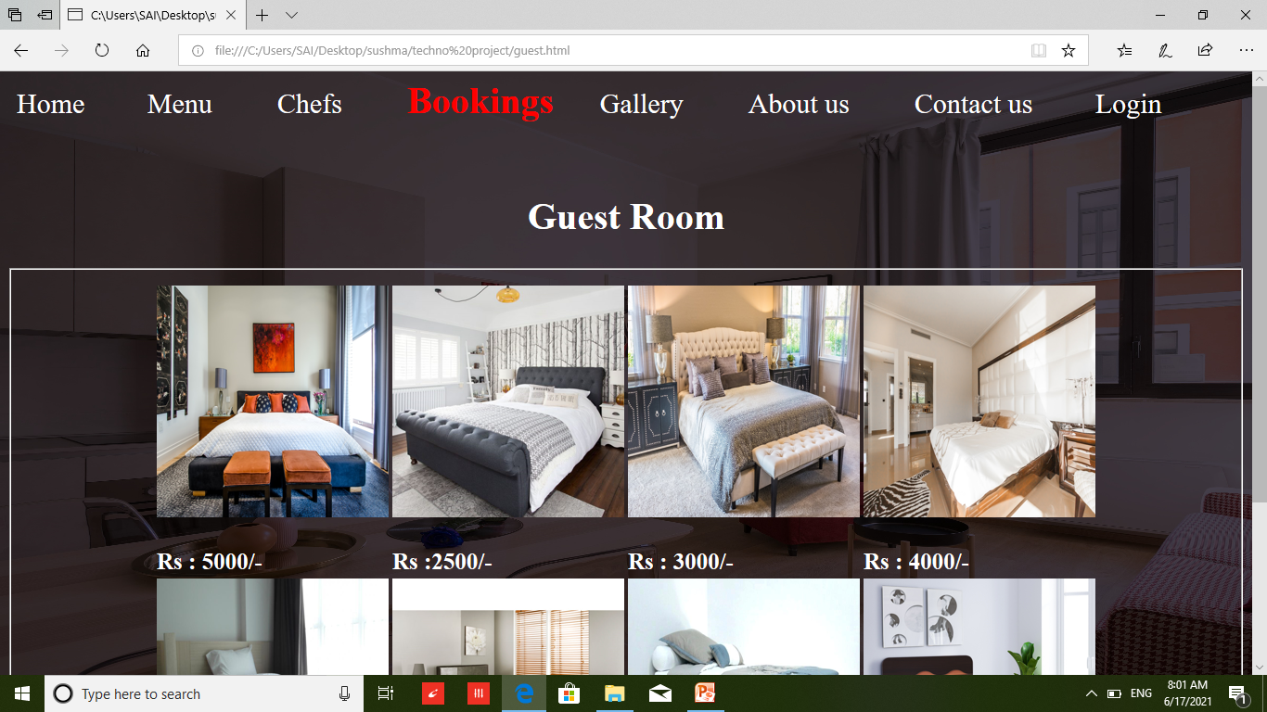
Guest Room :

Slide 17
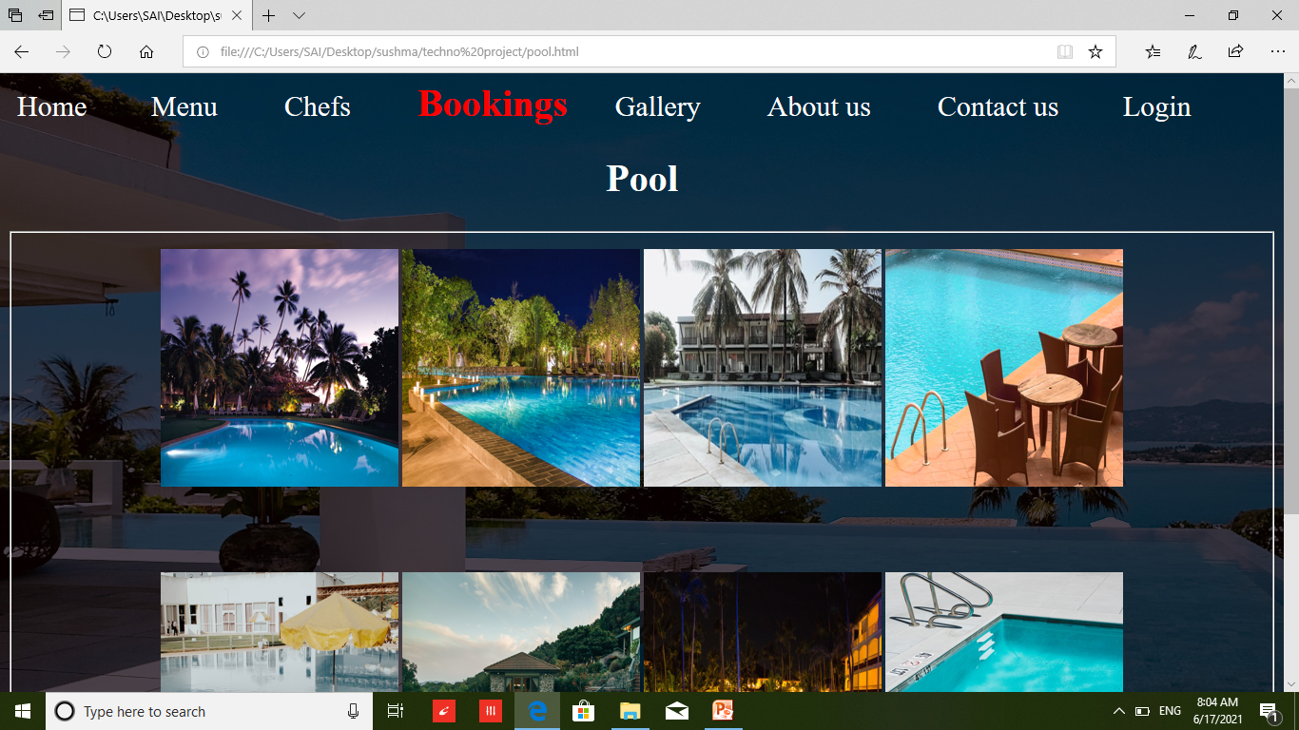
Pool :

Slide 18
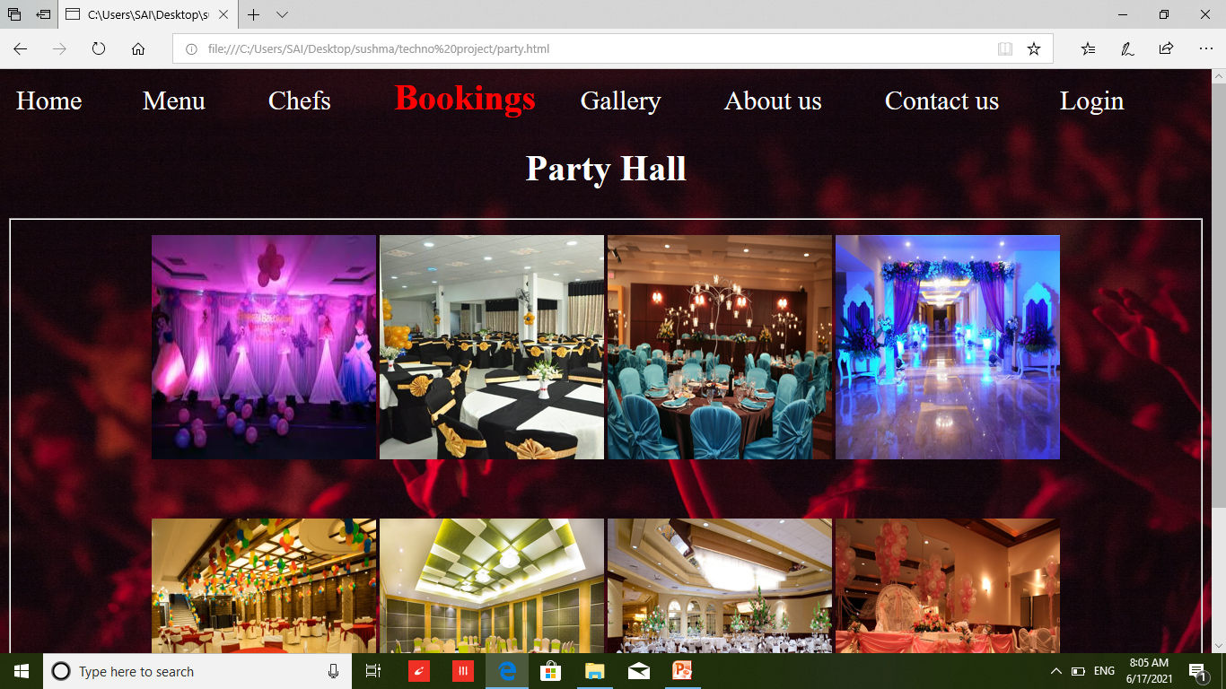
Party Hall :

Slide 19
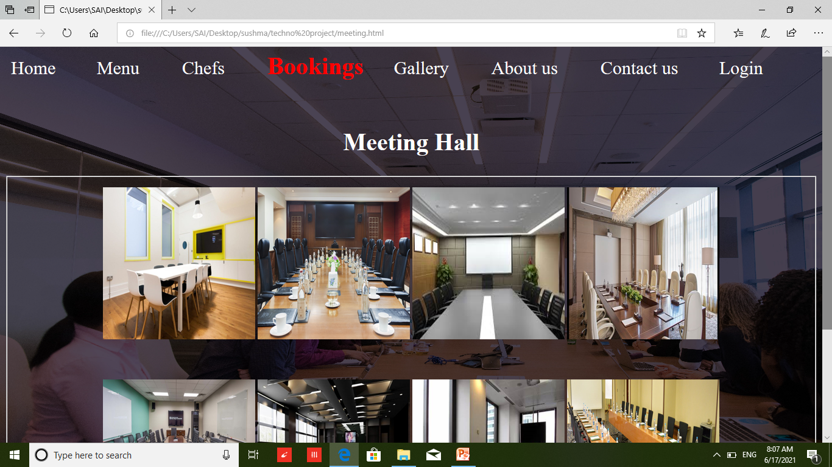
Meeting Hall :

Slide 20
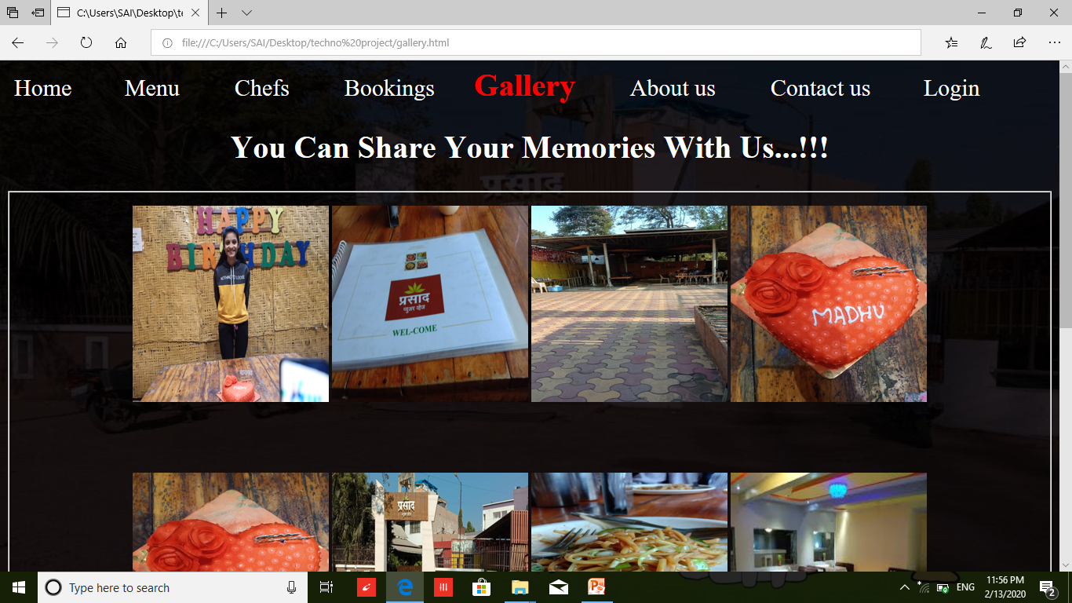
Gallery :

Slide 21
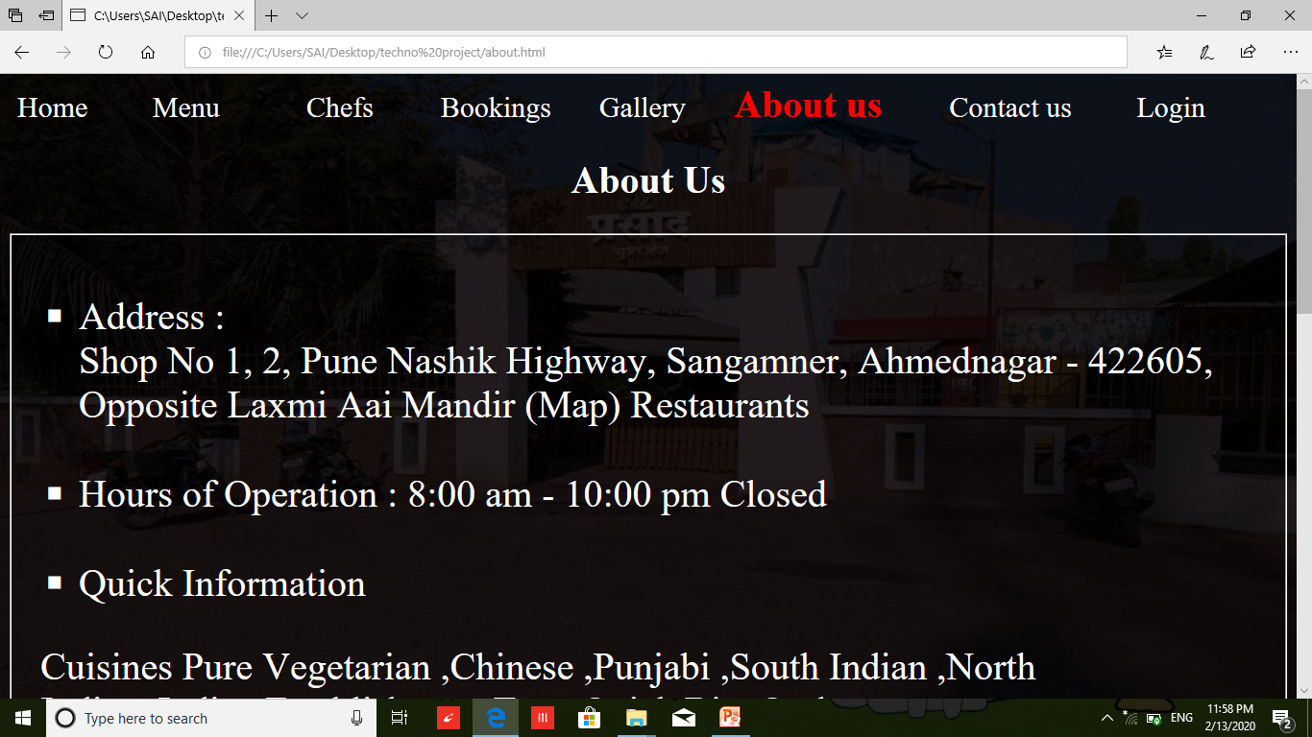
About Us :

Slide 22
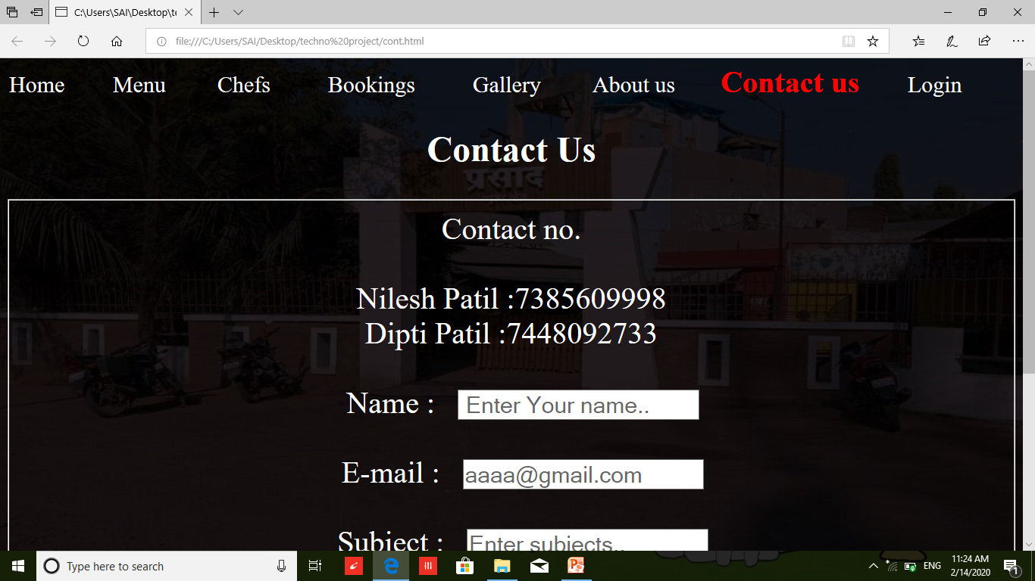
Contact Us :

Slide 23
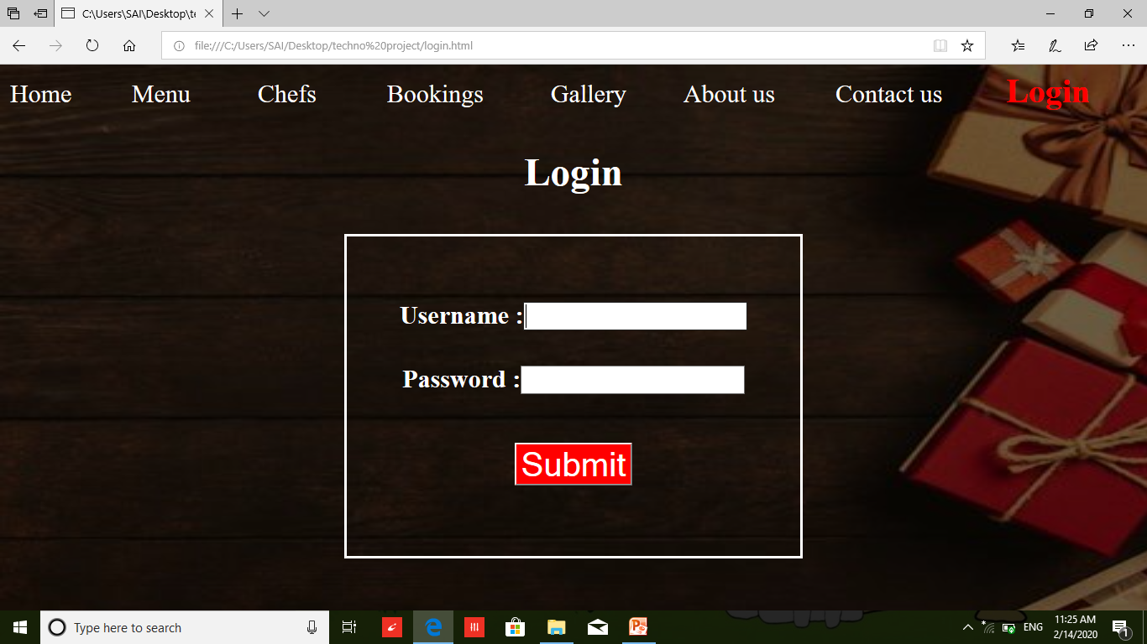
Login Page :

Slide 24
Reference :
Website:
www.W3school.com
Book:
Introduction to Web Technology
(Textbook-S.Y.BCA(science))
The Complete Reference HTML & CSS.
Web Designing & Development.

Slide 25
Thank you….!!!!

